Slide 1
RESTful services
Richardson Maturity Model – Martin Fowler

Slide 2
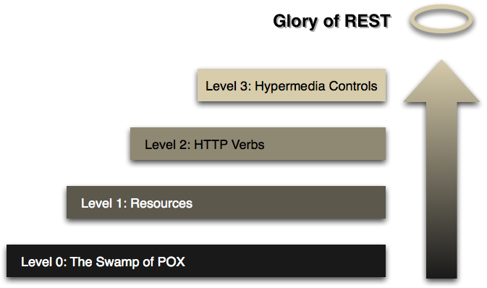

Slide 3
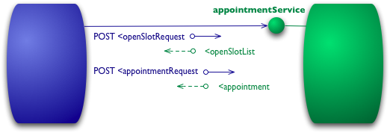
Level 0
HTTP as a transport system for remote interactions
HTTP as a tunneling mechanism for your own Remote Procedure Invocation
the content can actually be anything: JSON, YAML, key-value pairs, or any custom format

Slide 4
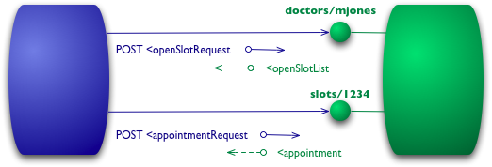
Level 1
The next step is the introduction of “resources”
Instead of endpoints, we start communicating with resources
Very similar to Object Oriented Programming Concepts

Slide 5
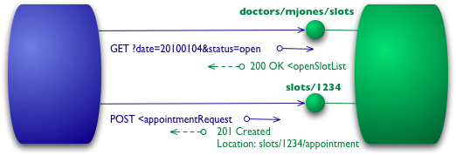
Level 2
Using the HTTP verbs as closely as possible to how they are used in HTTP itself
Interpretation
GET (collection)
GET/id (individual)
POST (creation)
PATCH/id (update individual)
DELETE/id (delete individual)

Slide 6
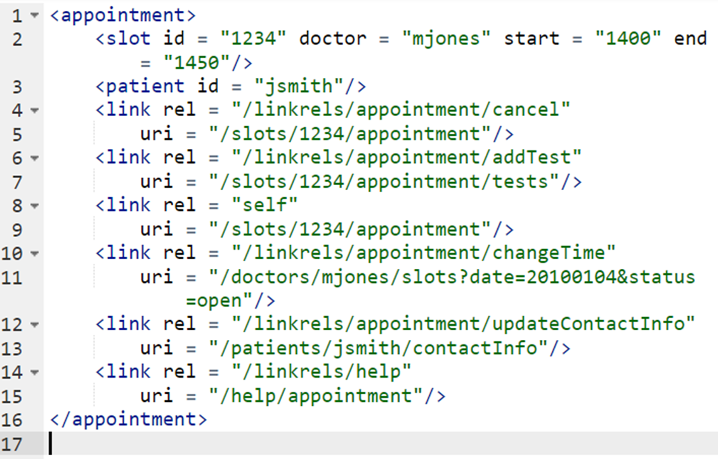
Level 3
HATEOAS (Hypertext As The Engine Of Application State)
Hypermedia controls is that they tell us what we can do next, and the URI of the resource we need to manipulate
One obvious benefit of hypermedia controls is that it allows the server to change its URI scheme without breaking clients
There's no absolute standard as to how to represent hypermedia controls. The ‘REST in Practice’ team, recommends ATOM (RFC 4287)

Slide 7
RESTful Services
The Driver’s view

Slide 8
“Representational State Transfer (REST) is an architectural style that specifies constraints, such as the uniform interface, that if applied to a web service induce desirable properties, such as performance, scalability, and modifiability, that enable services to work best on the Web”
- IBM
“ A REST API (also known as RESTful API) is an application programming interface (API or web API) that conforms to the constraints of REST architectural style and allows for interaction with RESTful web services. REST stands for representational state transfer and was created by computer scientist Roy Fielding. ”
- RedHat

Slide 9
Guidelines for Restful service
Think Resources not End Points
There should be a way to uniquely identify each resource. URI is the de facto standard.
Has similarities to Object Oriented Design
Uniform Interface
Piggy back on HTTP Verbs (GET, POST, PATCH & DELETE) and also HTTP Response Codes
Decoupled Representations
Content can be accessed in variety of formats (json preferred for webservices)
HATEOAS - Hypermedia as the Engine of Application State
Hyperlink driven, explicit state transfer, stateless otherwise

Slide 10
Guidelines (Extended)
Client- Server Architecture
RESTful style is mostly applicable (only) for ‘web’-services
Stateless Communication
No client information is stored between requests and each request is separate and unconnected
Cacheable Data
Cache wherever applicable to cutdown on roundtrips
Note: Remember that there is no authority for styles. Once you are developer, prepare yourself for heated water cooler debates about what should and should not be included in the RESTful style..

Slide 11
Guidelines (Extended)
Client- Server Architecture
RESTful style is mostly applicable (only) for ‘web’-services
Stateless Communication
No client information is stored between requests and each request is separate and unconnected
Cacheable Data
Cache wherever applicable to cutdown on roundtrips
Note: Remember that there is no authority for styles. Once you are developer, prepare yourself for heated water cooler debates about what should and should not be included in the RESTful style..

Slide 12
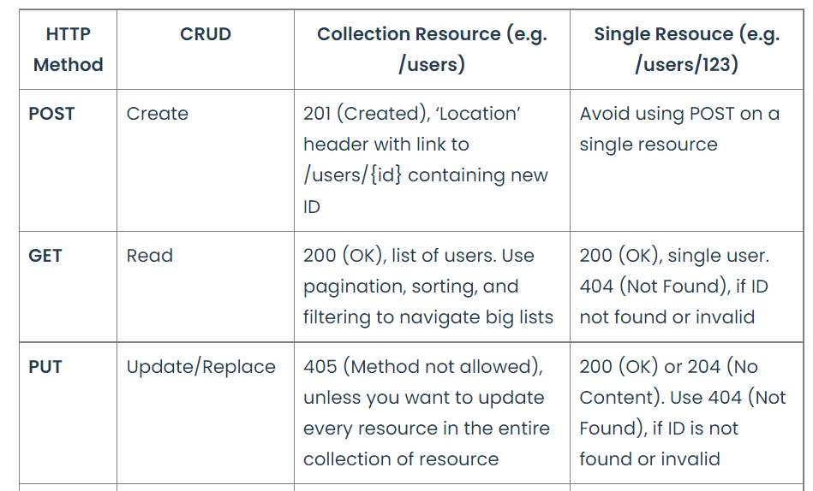
HTTP METHODS/VERBS

Slide 13
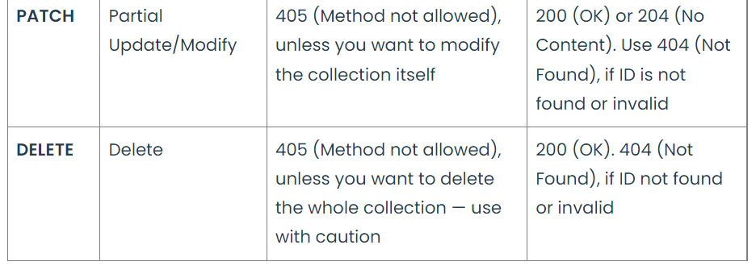
HTTP METHODS/VERBS

Slide 14
HTTP RESPONSE CODES
HTTP defines standard status codes that can be used to convey the results of a client’s request. The status codes are divided into five categories.
1xx: Informational – Communicates transfer protocol-level information.
2xx: Success – Indicates that the client’s request was accepted successfully.
3xx: Redirection – Indicates that the client must take some additional action in order to complete their request.
4xx: Client Error – This category of error status codes points the finger at clients.
5xx: Server Error – The server takes responsibility for these error status codes.
https://restfulapi.net/http-status-codes/

Slide 15
HTTP RESPONSE CODES – IMPORTANT ONES
200 OK Indicates that the request has succeeded.
201 Created Indicates that the request has succeeded and a new resource has been created as a result.
400 Bad Request The request could not be understood by the server due to incorrect syntax. The client SHOULD NOT repeat the request without modifications.
401 Unauthorized Indicates that the request requires user authentication information. The client MAY repeat the request with a suitable Authorization header field
404 Not Found The server can not find the requested resource.
500 Internal Server Error The server encountered an unexpected condition that prevented it from fulfilling the request.

Slide 16
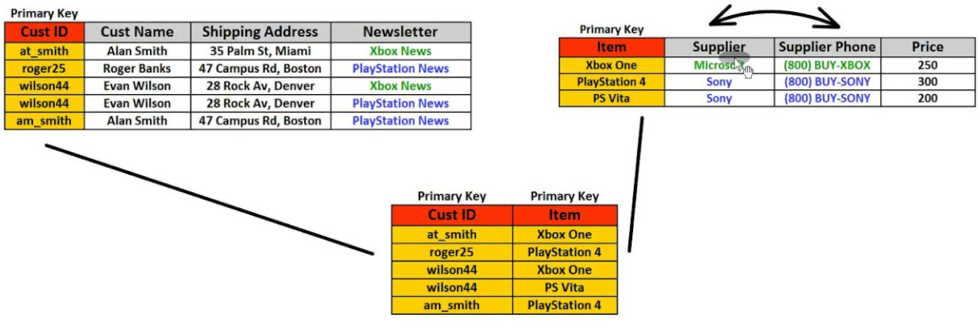
Customer
Products
Join

Slide 17
